Slide 1
Iris Flower Machine Learning
A Project

Slide 2
Background
Iris Plant Classification
50 Samples Of Each Species
Iris Setosa, Iris Versicolor, Iris Virginica
Attributes: Petal Length, Petal Width, Sepal Length, Sepal Width

Slide 3
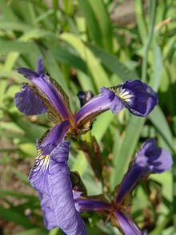
Iris Setosa
Petal Length; Min: 4.3, Max: 5.8, Mean: 5.006
Petal Width; Min: 2.3, Max: 4.4, Mean: 3.428
Sepal Length; Min: 1, Max: 1.9, Mean: 1.462
Sepal Width; Min: 0.1, Max: 0.6, Mean: 0.246

Slide 4
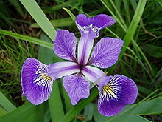
Iris Virginica
Petal Length; Min: 4.9, Max: 7, Mean: 5.936
Petal Width; Min: 2, Max: 3.4, Mean: 2.8
Sepal Length; Min: 3, Max: 5.1, Mean: 4.35
Sepal Width; Min: 1, Max: 1.8, Mean: 1.326

Slide 5
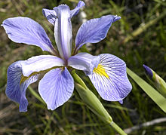
Iris Versicolor
Petal Length; Min: 4.9, Max: 7.9, Mean: 6.588
Petal Width; Min: 2.2, Max: 3.8, Mean: 2.974
Sepal Length; Min: 4.5, Max: 6.9, Mean: 5.55
Sepal Width; Min: 1.4, Max: 2.5, Mean: 2

Slide 6
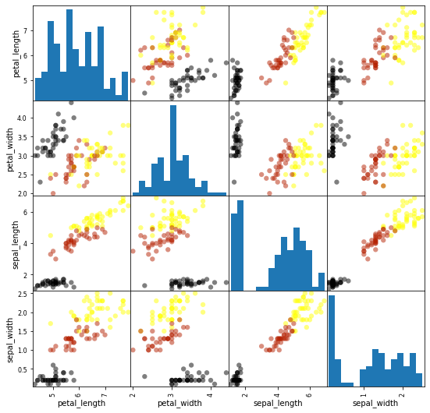
Data Visualized

Slide 7
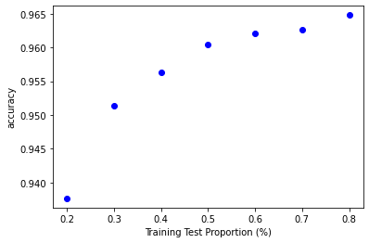
Results - Training Test Proportions

Slide 8
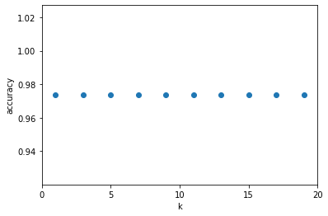
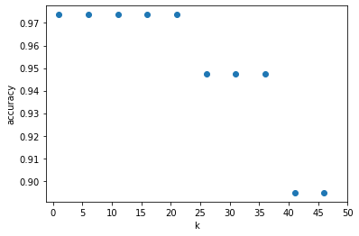
Results - k values
Before
After

Slide 9
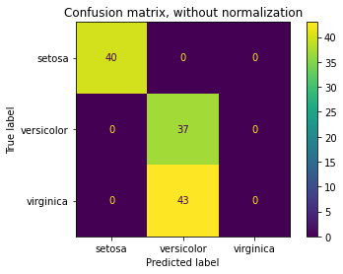
Results - Confusion Matrix

Slide 10
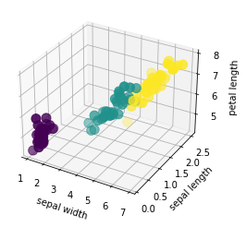
Extra Considerations
Only 3 dimensional
Setosa different
Versicolor and Virginica close

